Slide 1
Deployment Dragons
Joe Putz Jorge Luis Canales Jr. Mehedi Waheed Meem
Scope
Back-end:
Java, Python, and Apache
Front-end:
React, Angular, Javascript, CSS, HTML, and Bootstrap
Database:
MYSQL & MYSQL Workbench GUI, and AWS RDS
DevOps & Additional Tools:
Docker, Kubernetes, Minikube, AWS EKS, AWS ECS, Terraform, Jenkins, SonarQube, Swagger, Postman, Git, and AWS CLI
Collaboration & Project Management:
Jira, Confluence, and Teams

Slide 2
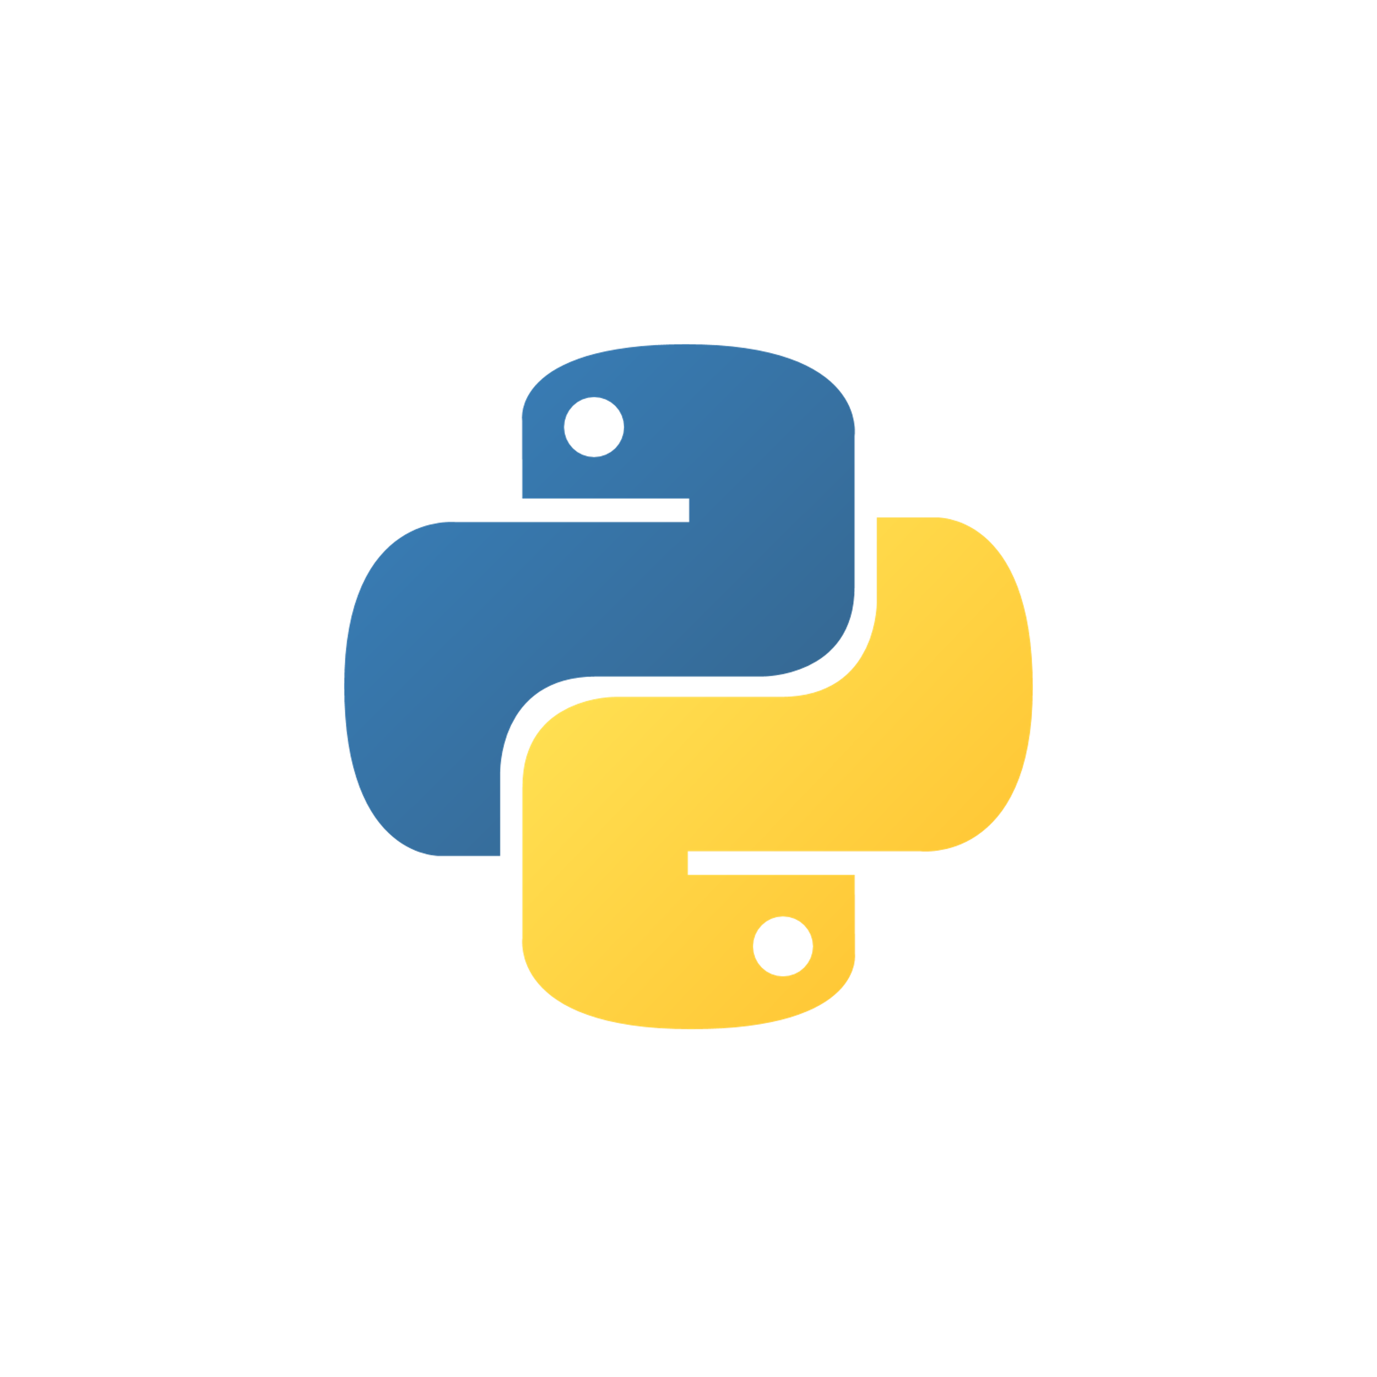


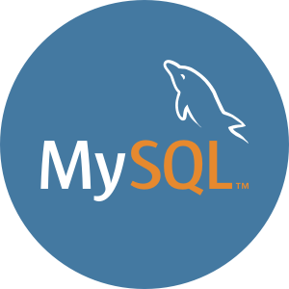
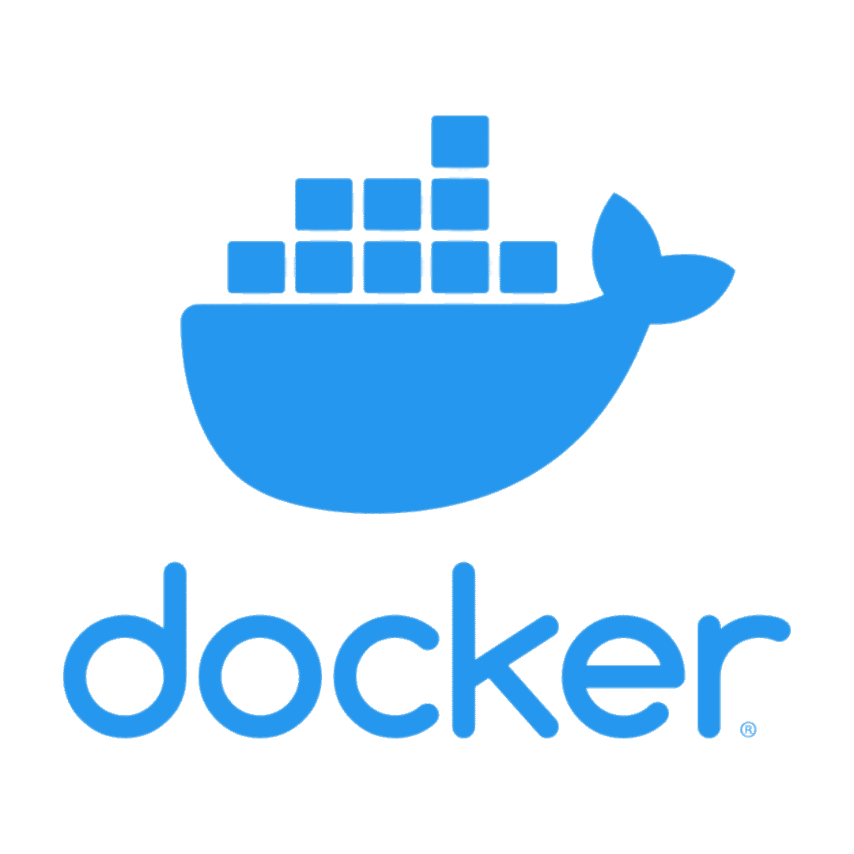
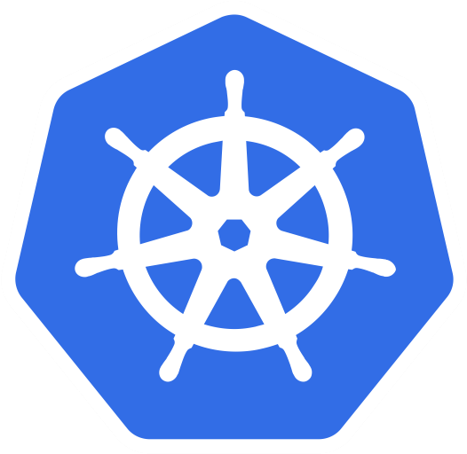

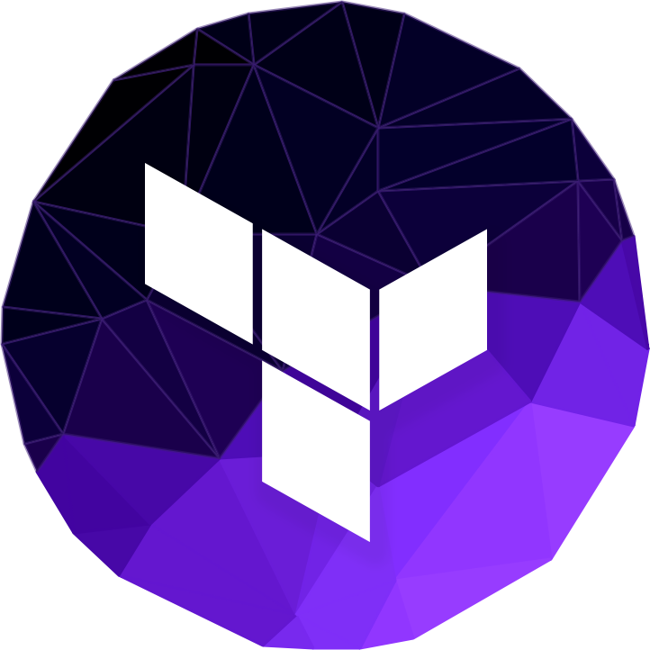



Aline Financial
We are deploying the Aline Financial Bank application, which consists of 5 microservices, 1 gateway, 3 frontend portals, and a MySQL database. This application is designed to handle user registration, applicant management, application management, bank/branch management, account creation/management, and account transactions.
Project Overview
Technologies & Tools
Notes:
Python, fargate, gitlab, draw.io, terraform, mysql, docker, kubernetes, minikube, amazon aws services (EC2, RDS, ECS, EKS, ECR)

Slide 3
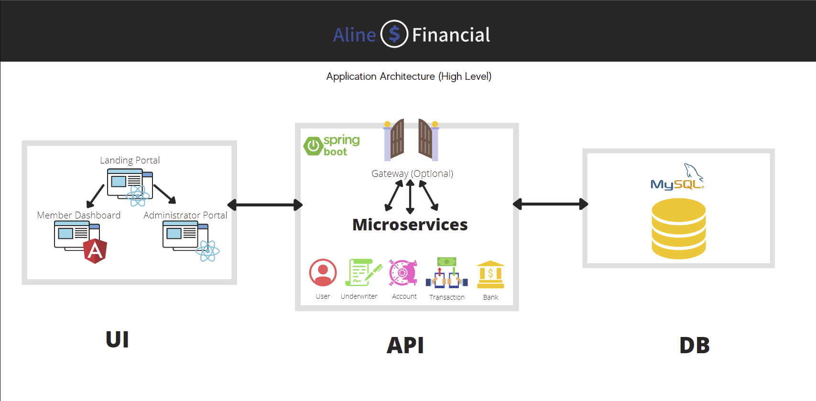
Microservice Architecture

Slide 4
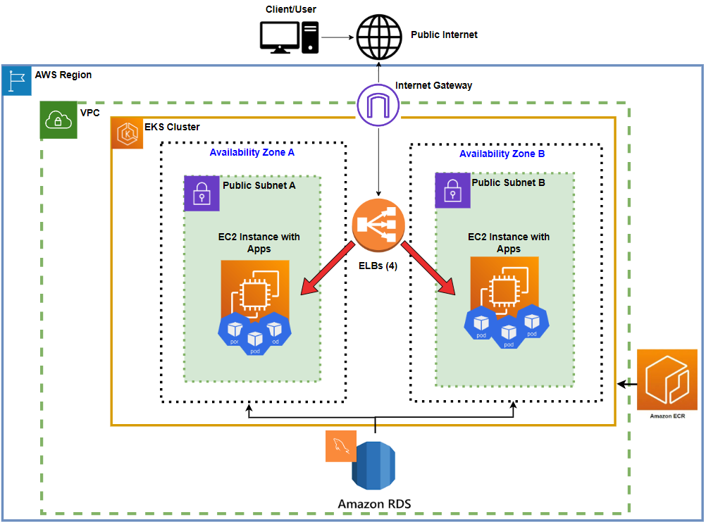
Cloud Architecture

Slide 5
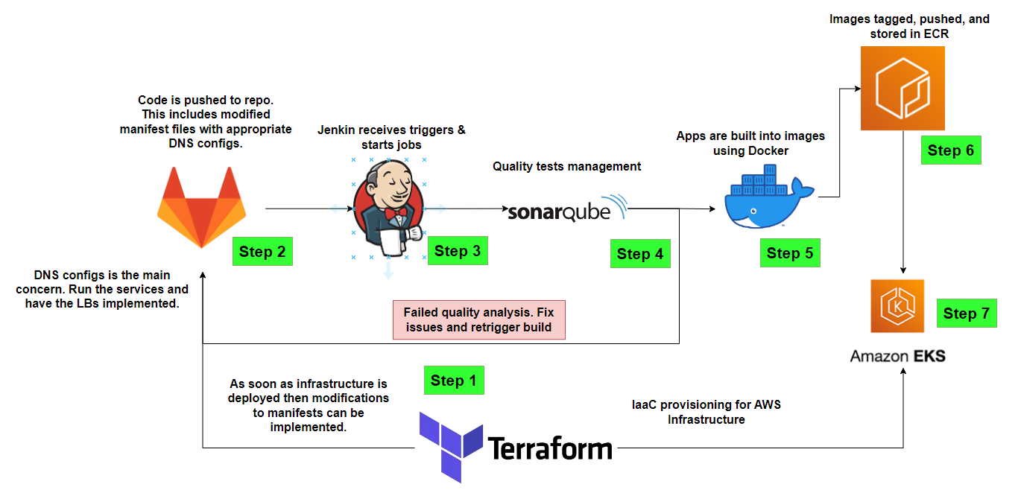
CI/CD Pipeline Architecture

Slide 6
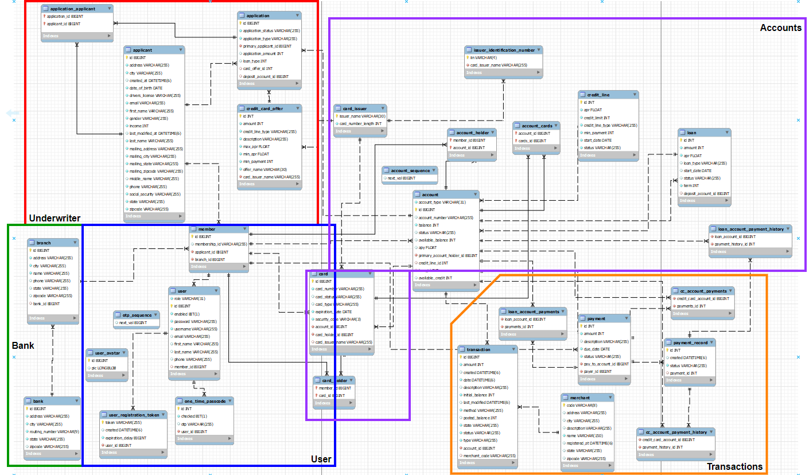
Database Schema

Slide 7
Use Case
The deployment and scalability of a banking app
Python and Mysql to generate data and save it for the aforementioned banking app
Dockerize images to create consistency in deployment
Use Kubernetes to allow deployment, automation, and management of the containerized app
Apply to AWS to allow the use of additional Amazon features
Use Terraform as a means of implementing Infrastructure as Code to create consistent deployments.
Use Jenkins for CI/CD automation
Use SonarQube for code analysis
Joe Putz

Slide 8
Responsibilities
Maintain the functionality and connectivity of the database and various services of the app
Generate necessary data
Dockerize the microservices, gateway, and portals
Deploy the images on various platforms including Minikube, AWS EKS, and AWS ECS
Provision the necessary infrastructure to create a working application
Implement an automation pipeline
Be efficient, and decrease costs where possible
Joe Putz

Slide 9
Implementation
Retrieve initial code, provision database, and test connectivity
Generate data through manual implementation as well as creation of functions
Create Docker images for the application
Implement the containerized app on various platforms (Minikube, AWS)
Deploy on AWS using RDS for the database, and EKS for the initial cluster configuration
Automate the provisioning of resources from AWS using Terraform
Follow the Agile Scrum framework to manage time and complete tasks
Use Jenkins to create an automated deployment pipeline

Slide 10
Live Demo

Slide 11
Use Case
Python Data Generation: Creating dummy data for testing and local development.
Docker Containerization: Ensuring consistent deployment with Docker.
Kubernetes Orchestration: Scaling and automating service management on AWS EKS/ECS.
Terraform Infrastructure Provisioning: Automating for reliable deployments and simplified management.
CI/CD Automation: Using Jenkins and SonarQube for deployment and code analysis.
Jorge Luis Canales Jr.

Slide 12
Responsibilities
Deploy an application to Amazon EKS using Jenkins and Docker images from ECR.
Installing all necessary plugins, dependencies, and packages needed processes
Create jobs/pipelines to automate processes
Build artifacts, push them to Amazon ECR, and perform code quality analysis with SonarQube using Jenkins.
Setup code quality testing and analysis
Jorge Luis Canales Jr.

Slide 13
Implementation
Pulled code from repository for local build and testing.
Used Python for comprehensive endpoint testing with dummy data.
Containerized applications using Docker, tested locally with Minikube.
Deployed and tested project on AWS EKS for scalability.
Automated infrastructure provisioning with Terraform for consistency.
Deployed application to Amazon EKS using Jenkins and Docker images.
Built artifacts, pushed to Amazon ECR, and analyzed code quality with SonarQube using Jenkins.
Utilized tech tools (Teams, Jira, Confluence) for agile development lifecycle along with team collaboration.

Slide 14
Live Demo

Slide 15
Use Case
Deploy a working banking application onto AWS
Setup database
Setup application executable files
Automate Data Generation
Containerize application
Automate Infrastructure to provision AWS EKS resources
Automate deployment of containers and services on AWS EKS
Mehedi Waheed
Meem

Slide 16
Responsibilities
Setup application executable jar and build files using appropriate env variables
Setup Database using MySQL
Automate data generation using Python
Containerize Application components such as microservices, gateway and front-end using Docker
Orchestrate Containers using Kubernetes
Provision AWS EKS resources using Terraform to launch infrastructure
Implement Sonarkube on Jenkins to evaluate code
Automate deployment of containers and services on AWS EKS using Jenkins to have a working app
Mehedi Waheed
Meem

Slide 17
Implementation
Retrieved application code from Gitlab repository
Setup a MySQL database for application
Setup application executable jar files for microservices and gateway and build files for front-end components using appropriate environmental variables
Automated data generation for application using Python to interact with application endpoints
Containerized application using Docker
Conducted local tests using a Minikube cluster
Orchestrated container deployments and services using Kubernetes
Deployed project with AWS using RDS, VPCs, EKS and ECS through the AWS console
Provisioned the same resources using Terraform to launch infrastructure as code
Using Jenkins, automated code evaluation using Sonarkube (in progress), deployment of containers and services, updating docker files based on services and rebuilding images, pushing images to ECR and redeployment of containers based on new ECR images
Followed the Agile SCRUM framework to achieve project goals
Planned and executed Sprints to deliver potentially shippable increments of the product
Used Microsoft Teams for daily standups to update the group on individual progress, blockers, and plans moving forward for the day
Utilized Jira to prioritize and track user stories, tasks and bugs and facilitate team communication
Used confluence to maintain project documentation such as discussing blockers and fixes, track meeting action items, and sprint retrospectives across the team

Slide 18
Live Demo

Slide 19
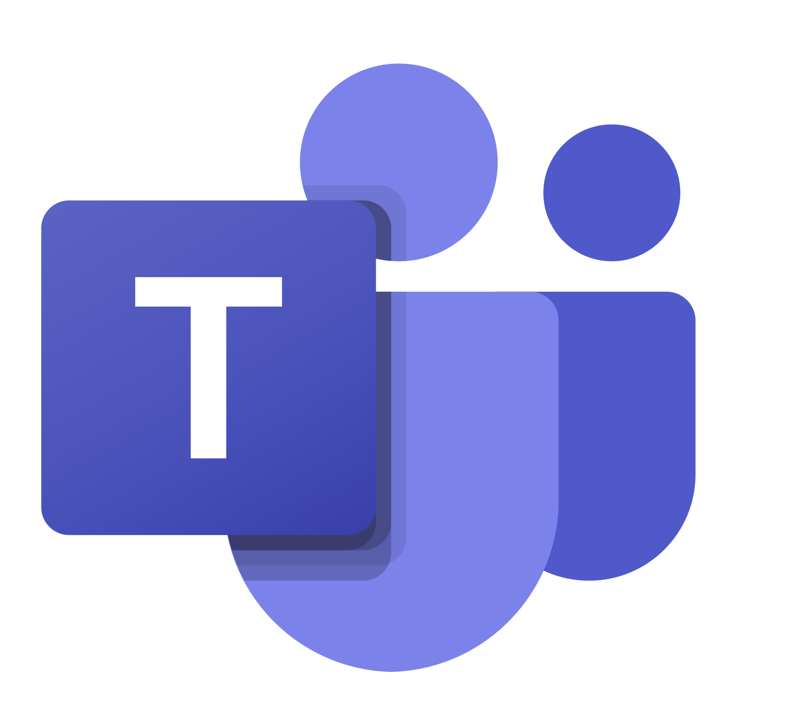


Teams
Collaboration &
Project Management
Jira
Confluence

Slide 20
Thank You!

